Slide 1
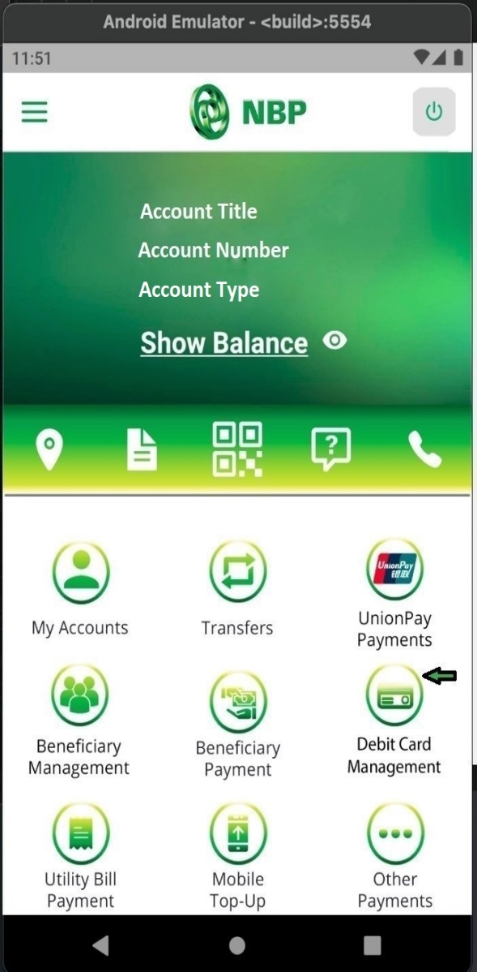
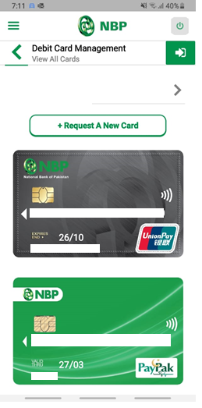
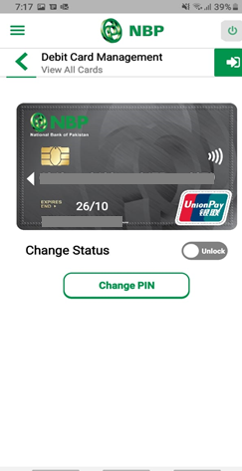
How to Change Debit Card Status?
Tap on “Debit Card Management”
Step-1
Tap on Card to change Status of the Card
Tap on radio button to Lock/Unlock Card
Step-2
Step-3

